Slide 1
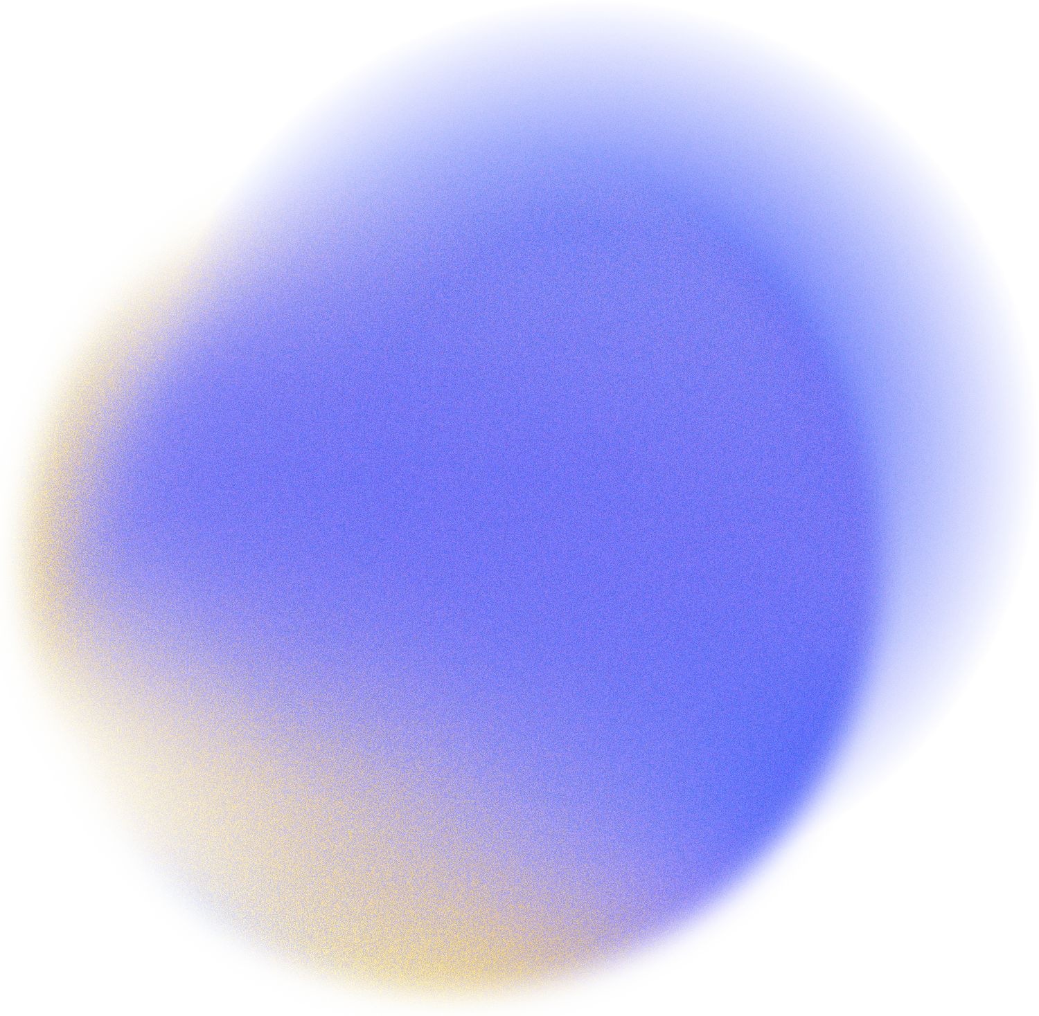
CSCE-625 Artificial Intelligence
Texas A&M University
SAM3 in Medical Imaging:
Optimizing Prompts for Skin Lesions
Taher Mustansir Bhurka (938005585) Jeet Ashokbhai Patel (138008847)
Yash Vijay Patil (738001186)

Slide 2

Problem Statement
The Clinical Need & The Domain Gap
High Cost of Manual Annotation: Precise skin lesion segmentation is critical for clinical AI but requires significant, time-consuming expert input.
The Domain Gap: Foundation models (SAM-2/SAM-3) offer fast, prompt-driven segmentation, but their heavy reliance on natural training images creates severe accuracy drops on complex medical data out-of-the-box.
Core Questions Addressed
Which zero-shot prompting strategy (point, box, text, or auto) produces the most accurate baseline segmentation for skin lesions?
Can lightweight, targeted fine-tuning of the mask decoder successfully bridge the medical domain gap and transform SAM-3 into a highly accurate clinical tool?

Slide 3
Dataset & Setup
The Data: ISIC 2018 (Skin Lesion Segmentation)
Volume: 1,000 dermoscopy images with ground truth masks.
Preprocessing: Standardized and resized to 1024×1024 strictly for SAM-3 vision encoder compatibility.
Data Split: 800 Training images / 200 Testing images
Hardware & Optimization Pipeline
Prototyping: Validated the baseline and code logic on an NVIDIA T4 (Google Colab Pro).
Fine-Tuning: Executed full training on an NVIDIA A100 (TAMU HPRC)

Slide 4
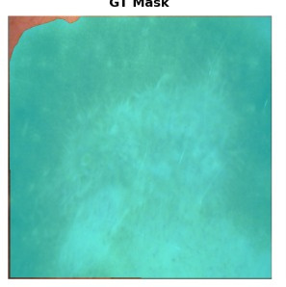
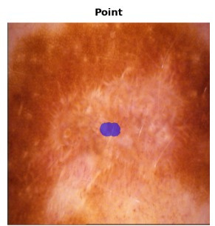
Baseline and Related work
SAM2 and SAM3 are state-of-the-art for natural image segmentation but lack semantic understanding of medical domains out-of-the-box
No prior work benchmarks SAM3 specifically on dermoscopic lesion segmentation
We evaluated Meta’s out-of-the-box SAM-2 and SAM-3 on 1000 images to establish a rigorous starting point and justify our fine-tuning approach.
What we Observed
Bounding-box prompts achieved reasonable baseline accuracy (0.65 Dice), but struggled on massive lesions.
Both models completely failed to understand single-point prompts.
SAM-3 exhibited a 93% failure rate (0.10 Dice score) on point prompts, proving the baseline model fundamentally lacks the semantic concept of a "skin lesion."

Slide 5



Method: SAM3 Architecture and Fine Tuning Strategy
The prompt encoder converts your bbox/point/text inputs into embeddings. It was kept frozen because the prompt representations are domain-agnostic — a bounding box means the same thing regardless of whether the image is natural or medical.
The backbone was completely frozen to preserve general image understanding (shapes, textures, edges) and avoid catastrophic forgetting. This also saved significant A100/T4 VRAM the backbone is the largest part of the model.
Image Encod
Image Encoder
Prompt Encoder
Patch Embed
Input
1024 X 1024
Transformer
Blocks
Mask Decoder
Tracker + Decoder
FPN Neck
Two way
Attention
Prediction mask + confidence
Frozen
MLP Head

Slide 6
Method: SAM3 Architecture and Fine Tuning Strategy
The decoder-only fine-tuning strategy was executed utilizing bfloat16 precision. By systematically bypassing SAM-3’s default inference locks, the mask decoder layers were isolated and trained over 25 epochs using an AdamW optimizer and Cosine Annealing. To maximize clinical accuracy, a combined Dice and Binary Cross-Entropy (BCE) loss was applied directly to the highest-scoring mask candidate, ensuring strict pixel-level precision and optimal boundary overlap.
Image Encod
Image Encoder
Prompt Encoder
Patch Embed
Input
1024 X 1024
Transformer
Blocks
Mask Decoder
Tracker + Decoder
FPN Neck
Two way
Attention
Prediction mask + confidence
Frozen
MLP Head

Slide 7
Exprimental Analysis:

Slide 8
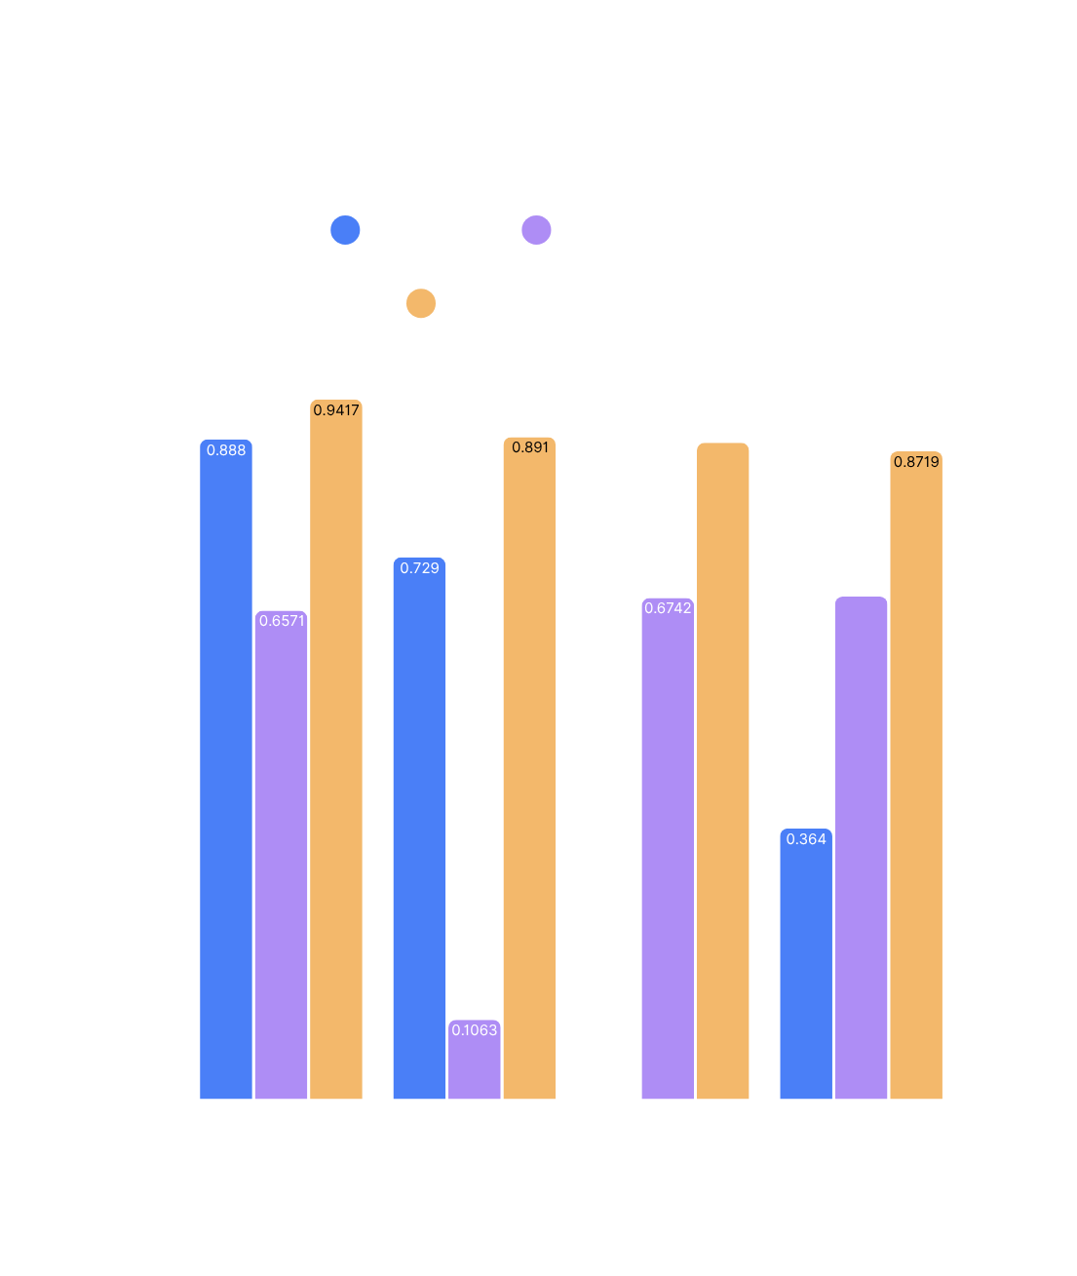
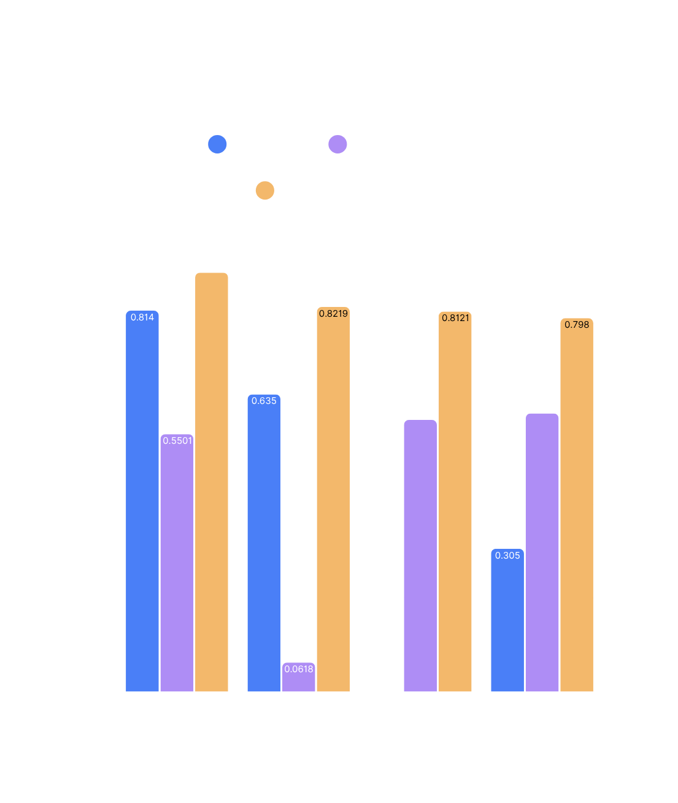

Slide 9
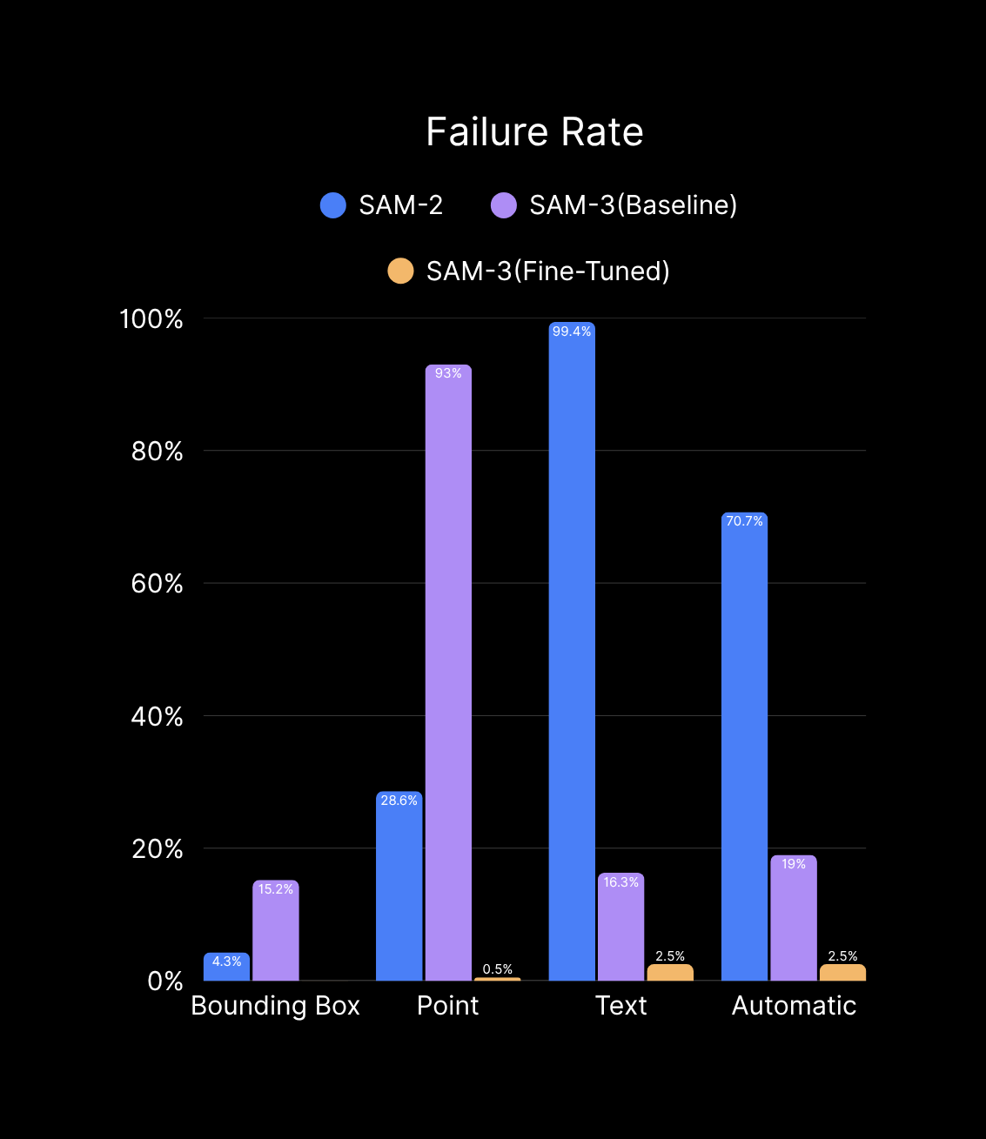

Slide 10
Conclusion & Clinical Implications
1. Bridging the Domain Gap
Conclusion: Relying on out-of-the-box foundation models for specialized medical tasks is insufficient. However, lightweight, decoder-only fine-tuning can bridges this gap.
2. The Power of the Point Prompt
Discussion: The most significant breakthrough was rescuing the single-point prompt (from 93% failure down to 0.5%). This proves that AI can enable a "single-click" workflow for dermatologists, drastically reducing manual annotation time without sacrificing accuracy.
3. Architectural Reflection
Discussion: Our baseline anomaly (SAM-2 outperforming SAM-3) highlights the "Alignment Tax." As foundation models are heavily optimized for commercial video and natural images, they regress on complex medical data. Domain-specific adaptation will remain a mandatory step for medical AI.

Slide 11
Thank
You

